Slide 1

01/09 2022 Meeting
Sjur Beyer

Slide 2
Plan for this meeting
Surficial project overview of NGI’s work on TNWWFZ
more in depth/specific discussions in the future
Go through the methods, available data
Setting a baseline for cooperation
Outlining the way forward

Slide 3
Working title
Predicting offshore soil properties using Machine Learning Techniques

Slide 4
Key project motivations
«Reliably predict information across the development area that engineers and other end-users can use in their application»
The seismic inversion algorithm is slow
Training a ML model will be faster
Explore applications of ML in earth science
Especially 2D TCN seismic inversion and transfer learning
Working cross-disciplinary
[computer science, geology, geophysics, geotechnics, geostatistics]

Slide 5
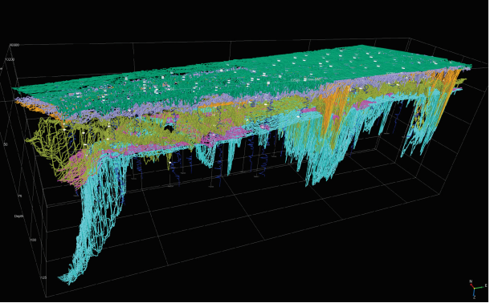
Ten noorden van de Waddeneilanden WFZ
Seismic data has been through seismic inversion
Good ground truth basis for training and testing
NGI has provided a machine learning deliverable for the project
Good grounds for comparison of model performance

Slide 6
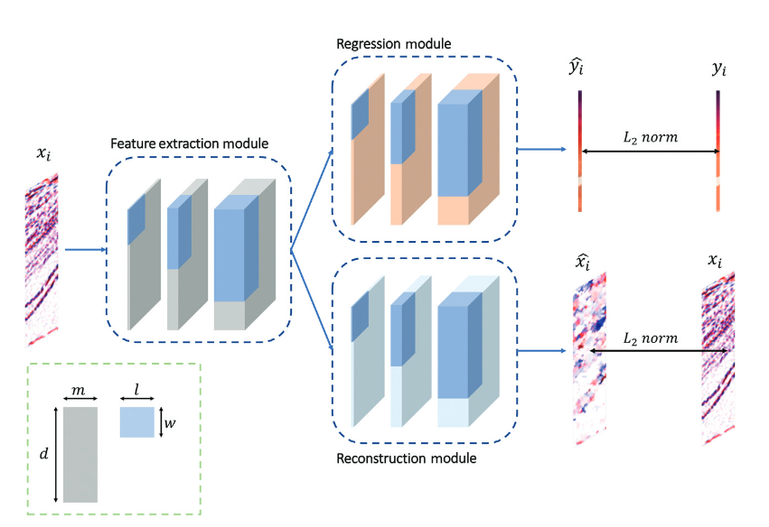
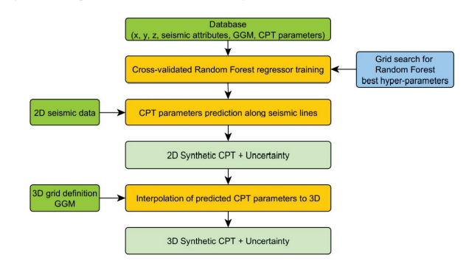
Project

Slide 7
Status
Currently I’m reading the reports associated with the project and taking notes. I started with the IGM report, but I plan to read the GGM and GIR as well.
I was hoping to be finished with reading the IGM report before this meeting, but other things took more time than anticipated
I’m anticipating things taking longer than anticipated, so we’ll see how that works out..

Slide 8
Timeline of work
I would like to have the ML working by christmas
Retrain the randomly initialized network regularly to investigate multiple minima
Depending on how well it’s going, it may be possible to extend the scope of work to also include the geostatistical 3D interpolation
New updates about the status will come regularly
At least in every general meeting (monthly), maybe elsewhere as well

Slide 9
Resources (digital infrastructure)
Tensorflow.keras for the ML
I created a miniconda environment containing only relevant packages, will wait until I start running the algorithm to export a yml file to the repo
There is a github repository which will have alle the updated files
If you want access to the repo, I must add you as a contributor
Github issues, and work log
For writing I will use Overleaf:
https://www.overleaf.com/read/tzwckfrpfbvw
For citations I will be using Zotero

Slide 10
My expectations of you
Consultation and guidance
Progress with the thesis might stagnate while waiting for feedback or input from one of you. Therefore I expect you to be available and respond quickly (within reason)

Slide 11
My promises to you
I will be managing my time between different activities
Student assistant position during the fall semester
Playing in the revy band, and also playing elsewhere some days
I have a tendency to procrastinate
Long term plans make it so that I must finish within alotted time, and I’m motivated to do so
Therefore I will start more modestly (than I would like) with the scope of work and expand

Slide 12
Mutual expectations
Make notes of items of discussion, so they’re not lost
Use the discussion board on Teams
Respect each others time [wrt. work hours]. Includes notifying about not being available for meetings and respecting time for deliveries.
I will be available all weekdays, mainly from 9 to 17

Slide 13
Groups and meetings
Given some of the lack of overlap between your areas of expertise, ceratin discussions/meetings will necessarily be quite boring and unnecessary for most participants. Therefore I created subteams with their own channel on MS Teams
Everyone agree with the groups they are assigned?
General | Everyone
Academics and Writing | Maarten & Bjørn
Geology | Bjørn
Geophysics | Guillaume & Maarten
Geostatistics | Steinar (& Guillaume?)
Geotechnics | Vishal (& Maarten?)
Machine Learning | Guillaume

Slide 14
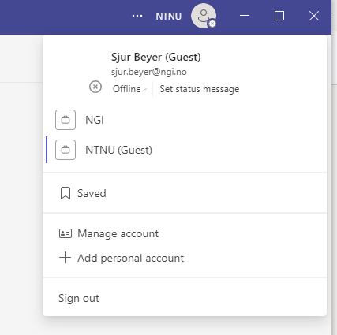
Accessing the team
It might take a little while before it appears in your MS Teams

Slide 15
Next meeting
I’m planning to schedule a ML meeting in two weeks [14.09.2022]
By then I want to have:
Implemented all needed architectures
Implemented transfer learning loss functions
Implemented logging script
Gotten familiar with loading the data from NGI’s TNW folder (OpendTect etc.)
Ran at least one algorithm with summary statistics
Or at the very least have better questions to ask for guidance
Next general meeting in one month [06.10.2022]
It will be beneficial for me to give status updates along the way and sharing plans ahead

Slide 16
Thoughts / Feedback ?

Slide 17
Discussion
Do you want access to the GH repo
Geobody, seismic blind spot
Summary statistics of soil unit parameters
Some engineering judgement involved in assigning these
Might be better to predict geotechnical design parameters directly? Not through CPT response.

